Slide 1



STRATEGIC LISTENING EFFECTIVESS AUDIT© RESULTS
organization
department
date
© 2025 The Leadership & Listening Institute, Inc.

Slide 2

A tool to measure how listening is practiced and reinforced through leadership, culture, systems, and accountability

Slide 3
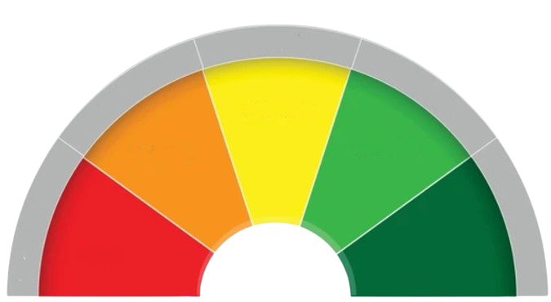
STARTEGIC LEVELS
Level 3
EMERGING
Level 2
EXPLORING
Level 4
TRANSFORMING
Level 1
INACTIVE
Level 5
STRATEGIC
© 2025 The Leadership & Listening Institute, Inc.

Slide 4
THE 5 STRATEGIC LISTENING LEVELS
Level 5: Strategic - Listening embedded in leadership, culture, and decisions.
Level 4: Transforming - Listening widespread, supported by systems, but not fully aligned.
Level 3: Emerging - Listening growing, with early intentional practices.
Level 2: Exploring - Listening valued but informal and inconsistent.
Level 1: Inactive - Listening absent, with little priority or support.

Slide 5
THE 6 LISTENING ORGANIZATION FACTORS
Listening Mindset
Believe that listening is essential to leadership, culture, and strategy, and that it can be intentionally learned and improved.
Listening Development
Build listening skills through ongoing training, coaching, and practice that strengthen both awareness, discipline, and performance.
Listening Systems
Embed listening into organizational structures and processes so it happens consistently and purposefully.
Listening Systems

Slide 6
THE 6 LISTENING ORGANIZATION FACTORS
Listening Spaces
Create physical and digital environments where people feel safe, respected, and confident their input matters.
Listening Accountability
Hold leaders and teams responsible for listening well and following through on what they hear.
Listening Measurement
Track how listening is practiced and how it impacts relationships, decisions, and results.

Slide 7
level
organization
department
date
((score))

Slide 8
SCORES BY FACTOR AND LEVEL
Listening
Mindset
Listening
Development
Listening
Systems
Listening
Spaces
Listening
Measurement
Listening
Accountability

Slide 9
Top 10 challenges that most apply to our organization today

Slide 10
How important is listening in your current position?

Slide 11
What is the most important listening challenge our organization faces today?
Open Ended 1

Slide 12

LEVEL 1
INACTIVE

Slide 13


Like an unused meeting room, strategic listening potential exists but the real conversations about what matters most have yet to begin.

Slide 14
What Is Dynamic Listening?
A natural and learned human behavior that uses all our senses to fully receive, interpret, evaluate, respond appropriately, and remember (SIER*) messages in ways that build trust, create alignment and drive strategic action.
What Is Dynamic Listening?
A natural and learned human behavior that uses all our senses to fully receive, interpret, evaluate, respond appropriately, and remember (SIER*) messages in ways that build trust, create alignment and drive strategic action.
© 2025 The Leadership & Listening Institute, Inc.

Slide 15

DYNAMIC DIALOGUE
What stands out most in our results?

Slide 16
DYNAMIC DIALOGUE
Where are we already listening well, and how can we build on those strengths?

Slide 17
DYNAMIC DIALOGUE
Which challenge should we focus on first to make a big impact? Why?

Slide 18
DYNAMIC DIALOGUE
What risks do we face if we don’t act on these listening gaps now?

Slide 19
DYNAMIC DIALOGUE
What would be different in the way we make decisions and follow through if listening were strengthened as a core strategic practice?

Slide 20
